Slide 1
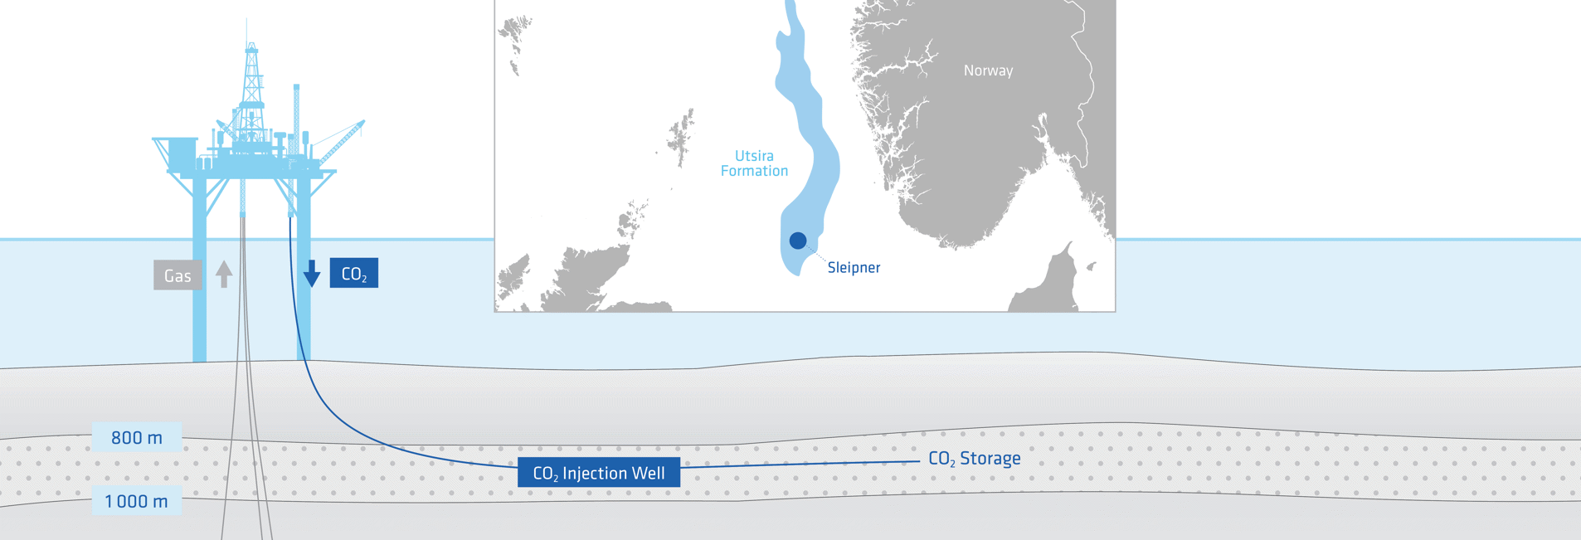

A physics-guided neural network-based inversion framework for geophysical monitoring of geological CO₂ storage
Student: Zeyu Wang
Chairman: dr. Eric Verschuur
Co-supervisor: dr. Jing Sun
Committee Member: dr. Rouhi Farajzadeh

Slide 2
Contents
Introduction
Data and Forward Modeling
Methodology
Results
Discussion
Conclusion

Slide 3

Chapter 1: Introduction
Why Geological CO₂ Storage (GCS) Matters
Greenhouse gas emissions are driving climate change; CO₂ is the main human-driven warming gas.
Cutting CO₂ is essential for climate goals and a net-zero 2050 pathway.
Geological CO₂ storage (GCS) injects captured CO₂ into deep formations for safe, long-term storage.
It is one of the few scalable options to lower atmospheric CO₂ at meaningful rates.
Proven examples: Sleipner and Northern Lights projects.

Slide 4
Chapter 1: Introduction
How do we monitor the CO₂ migration in the subsurface?
Time-lapse (4D) seismic monitoring is widely used to infer changes in reservoir state (e.g., saturation or pressure) from differences between base and monitor surveys.
In practice, inversion to impedance changes is often used to obtain clearer quantitative signatures than direct differencing of seismic amplitudes.
Two major families of inversion dominate the time-lapse literature: full- waveform inversion (FWI) and amplitude-versus-offset (AVO) inversion.
High accuracy, but computationally expensive and data-hungry for repeated monitoring.

Slide 5
Chapter 1: Introduction
Can we accelerate the inversion modeling at a lower cost?
ML can be used in solving inversion problem to achieve fast mapping angle gathers into saturation data, even with synthetic data.
Araya-Polo et al. trained seismic-to-model networks on synthetically generated seismic/velocity pairs; Liu and Zhong used synthetic elastic models to supervise inversion; Kazei et al. benchmarked deep-learning inversion on synthetic datasets.
But:
1) AVO analysis are missing multi-angle information; 2) No labeled data is available No field data is available either.

Slide 6
Chapter 1: Introduction
Main question.
Can we build a physics-guided neural network using multi- angle, time-lapse seismic AVO information to deliver reliable saturation monitoring for GCS while preserving angle seismic information and interpretability?
SQ1: Training strategy for an efficient seismic inversion. What training design enables a solver to perform seismic inversion efficiently and stably?
SQ2: Preserving angle seismic information in inversion. How can we retain and exploit the angle seismic information throughout the inversion pipeline—at input, forward operator, and loss—so that no angle seismic information averaging is performed?
SQ3: Feasibility and reliability of the prediction. How reliable is the physics-guided deep learning framework in producing operationally useful saturation maps across (i) plume localization and extent (IoU/centroid drift), (ii) boundary fidelity and amplitude consistency (NRMS), (iii) generalization to unseen time steps, and stability under noise and limited-angle conditions?

Slide 7
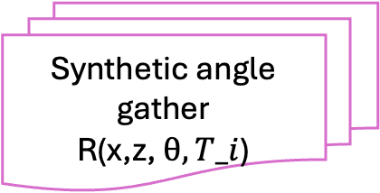
Fig.1 Pipeline overview of forward modeling
Chapter 2: Data and Forward Modeling
Full, frequency- and angle-dependent response of a horizontally layered medium(1D)
GT angle gather(1D)
Angle-dependent imaging
Wavelet
extraction
Reformat the image domain
Kennett's reflectivity method
Base-survey models
(Porosity, Density)
DARTS
Saturation map
Base-survey models
Density, Vp, Vs models at T_0
Geologic
assumption
Gasmann’s Law
Synthetic angle gather
R(x,z, $θ, T_i$)
PP reflection
coefficient at a single interface
Wavelet
covolution
Shuey’s
approx.
Elastic properties:
Density, Vp, Vs models at T_i
Notes:
.Angle-dependent imaging via linear Radon domain: 1)apply linear Radon/Tau-P transform of the data, to decompose in plane wave responses; 2)actual migration via phase shifts in Tau-P domain;
Select 4 angls from angle-dependent image and merge all over the lateral locations to generate 2D x,z images

Slide 8

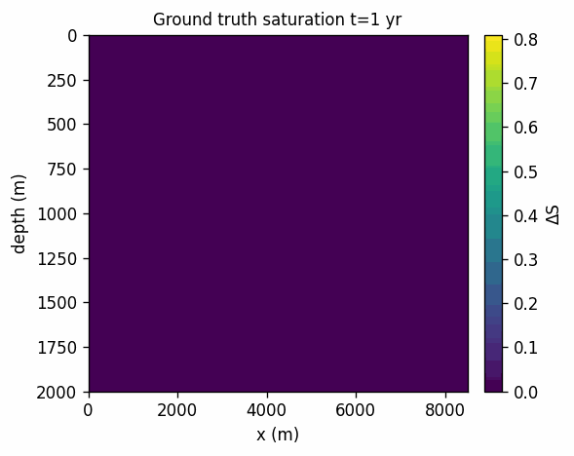
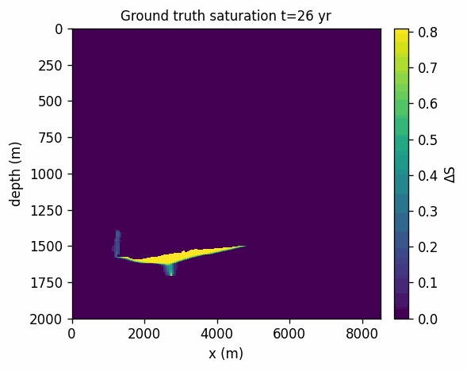
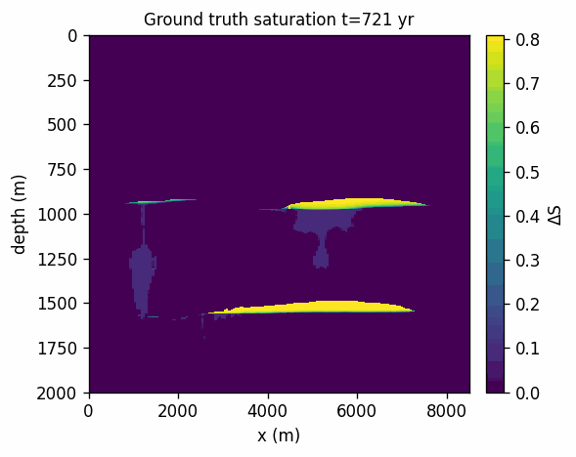
Chapter 2: Data and Forward Modeling
2.1 “GT” saturation simulation:
The 11th Society of Petroleum Engineers Comparative Solution Project (11th SPE CSP , https://spe.org/csp), is based around a synthetic geological cross section, representative of the structures found in the Norwegian Continental Shelf.
The public notebook runs on the Delft Advanced Research Terra Simulator (DARTS)
In this study we take the project’s porosity and facies description as the starting point for CO2 migration simulation.

Slide 9
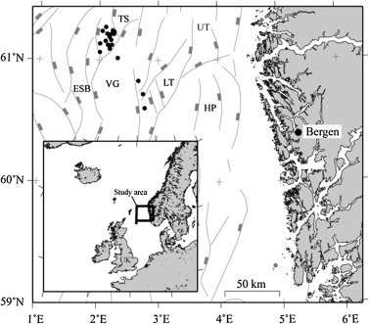
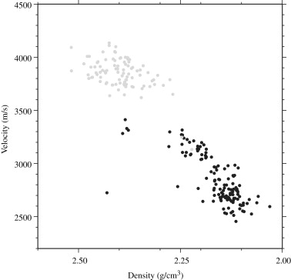
Chapter 2: Data and Forward Modeling
2.2 Geologic assumptions
Fig.2 Study area, northern North Sea
(Øyvind et al. 2010)
Fig.3 Relation of density and Vp of reservoir rock
in northern North Sea (Øyvind et al. 2010)

Slide 10
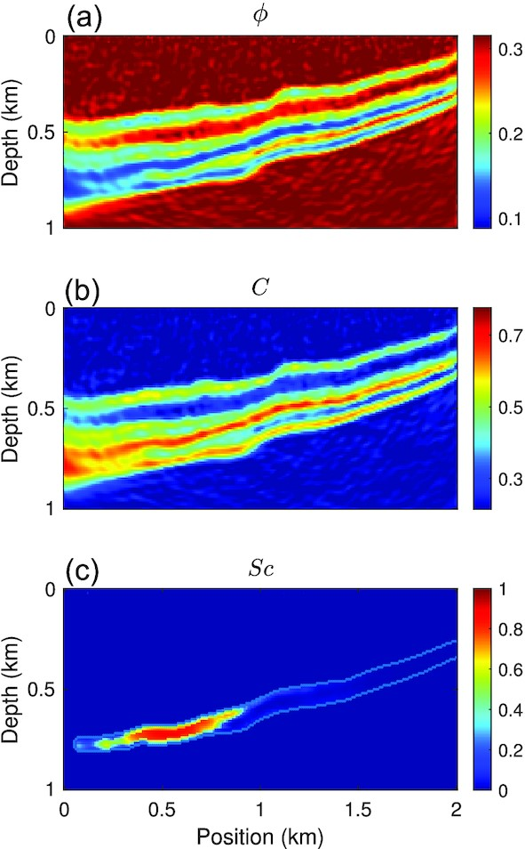
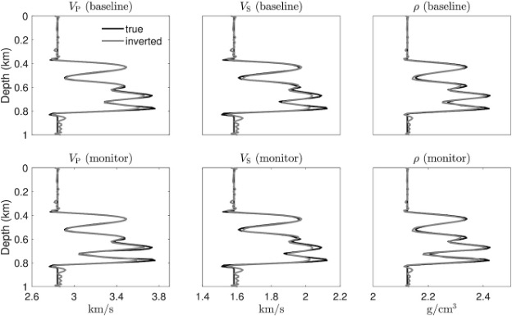
Chapter 2: Data and Forward Modeling
2.2 Geologic assumptions
(b)
Rock Physics:
Fig.4 Sleipner field: (a)Porosity model; (b) Vp, Vs, Density well logs; (c) Saturation of CO₂ when monitoring
(Hu et al. 2023.)
This practice was justified by the fact that highly complex structural settings are often avoided in GCS site selection (S. Khandoozi et al., 2023)

Slide 11
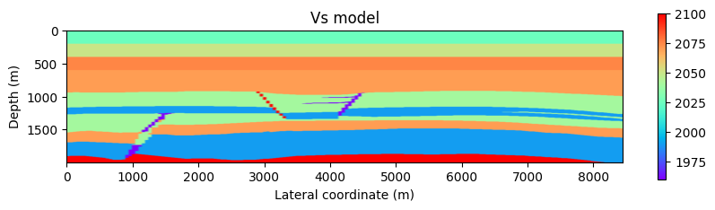
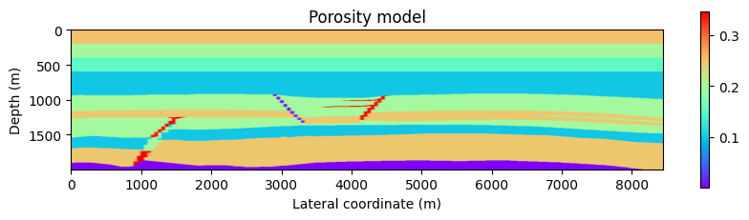
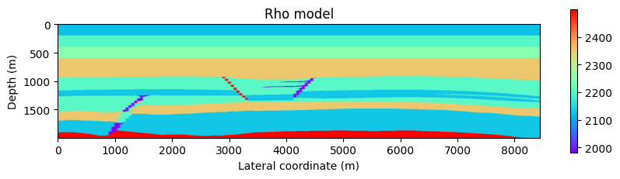
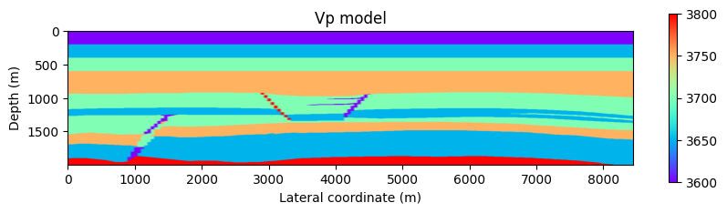
Chapter 2: Data and Forward Modeling
Fig.5 Base-survey elastic properties

Slide 12
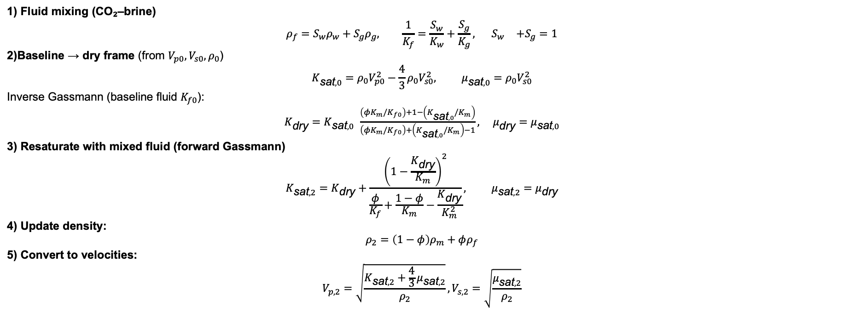
Chapter 2: Data and Forward Modeling
2.3 Elastic properties change computation
Gasmann’s law
Given baseline (V p1, V s1, ρ1) and porosity φ, the network predicts non-wet saturation Snw inside a reservoir.
1) Fluid mixing (CO₂–brine)
$$ρ_{f}=S_{w}ρ_{w}+S_{g}ρ_{g}, \frac{1}{K_{f}}=\frac{S_{w}}{K_{w}}+\frac{S_{g}}{K_{g}}, { S}_{w}+S_{g}=1$$
2)Baseline → dry frame (from $V_{p0},V_{s0},ρ_{0}$)
$$K_{\text{sat},0}=ρ_{0}V_{p0}^{2}−\frac{4}{3}ρ_{0}V_{s0}^{2}, μ_{\text{sat},0}=ρ_{0}V_{s0}^{2}$$
Inverse Gassmann (baseline fluid $K_{f0}$):
$K_{\text{dry}}=K_{\text{sat},0} \frac{\left(φK_{m}/K_{f0}\right)+1−\left(K_{\text{sat},0}/K_{m}\right)}{\left(φK_{m}/K_{f0}\right)+\left(K_{\text{sat},0}/K_{m}\right)−1}, μ_{\text{dry}}=μ_{\text{sat},0}$
3) Resaturate with mixed fluid (forward Gassmann)
$$K_{\text{sat},2}=K_{\text{dry}}+\frac{{\left(1−\frac{K_{\text{dry}}}{K_{m}}\right)}^{2}}{\frac{φ}{K_{f}}+\frac{1−φ}{K_{m}}−\frac{K_{\text{dry}}}{K_{m}^{2}}}, μ_{\text{sat},2}=μ_{\text{dry}}$$
4) Update density:
$$ρ_{2}=\left(1−φ\right)ρ_{m}+φρ_{f}$$
5) Convert to velocities:
$$V_{p,2}=\sqrt{\frac{K_{\text{sat},2}+\frac{4}{3}μ_{\text{sat},2}}{ρ_{2}}}, V_{s,2}=\sqrt{\frac{μ_{\text{sat},2}}{ρ_{2}}}$$

Slide 13
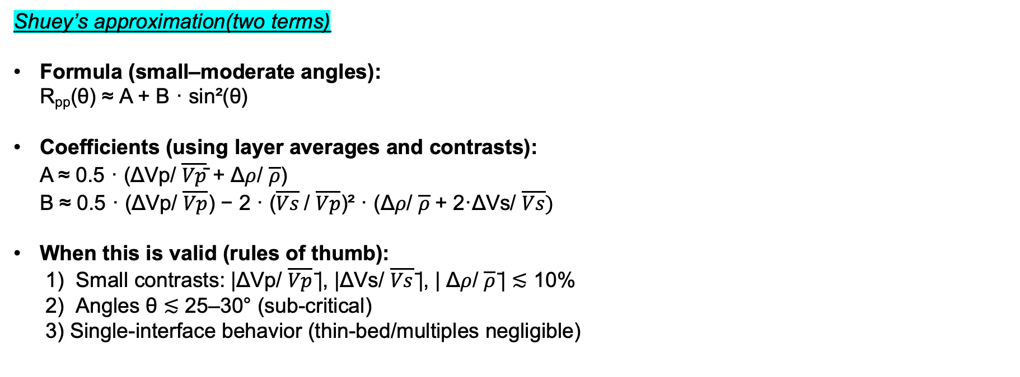
Chapter 2: Data and Forward Modeling
2.4 Reflection coefficient computation
Shuey’s approximation(two terms)
Formula (small–moderate angles): R_{pp}(θ) ≈ A + B · sin²(θ)
Coefficients (using layer averages and contrasts): A ≈ 0.5 · (ΔVp/ $\overline{Vp}$̄ + Δ$ρ$/ $\overline{ρ}$) B ≈ 0.5 · (ΔVp/ $\overline{Vp}$) − 2 · ($\overline{Vs}$/ $\overline{Vp}$)² · (Δ$ρ$/ $\overline{ρ}$+ 2·ΔVs/ $\overline{Vs})$
When this is valid (rules of thumb): 1) Small contrasts: |ΔVp/ $\overline{Vp}$̄|, |ΔVs/ $\overline{Vs}$̄|, | Δ$ρ$/ $\overline{ρ}$̄| ≲ 10% 2) Angles θ ≲ 25–30° (sub-critical) 3) Single-interface behavior (thin-bed/multiples negligible)

Slide 14
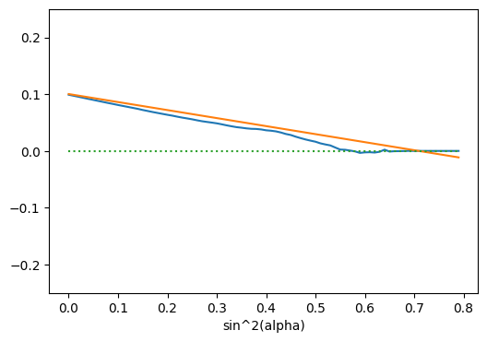
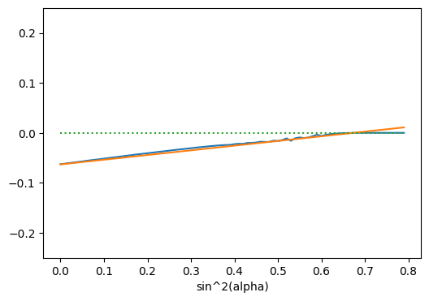
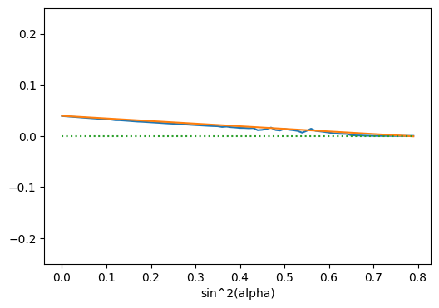
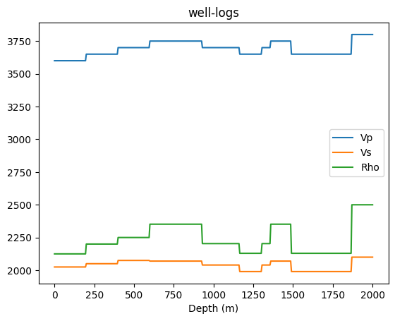
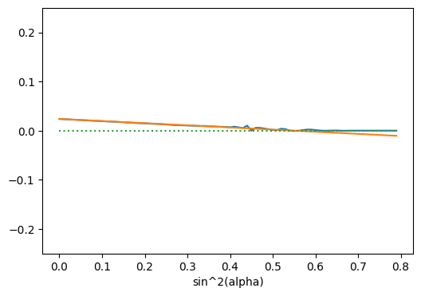
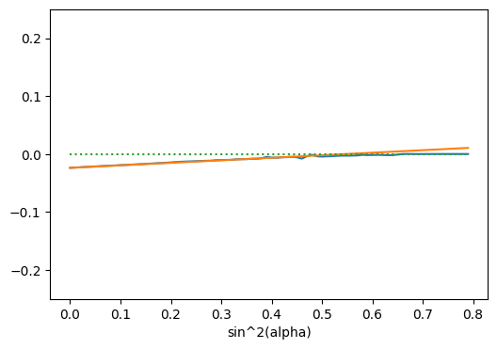
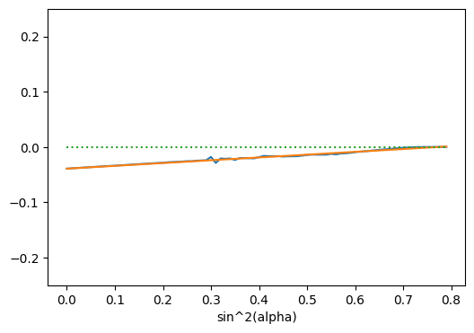
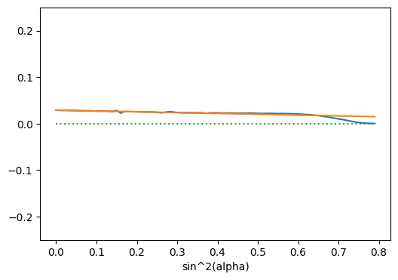
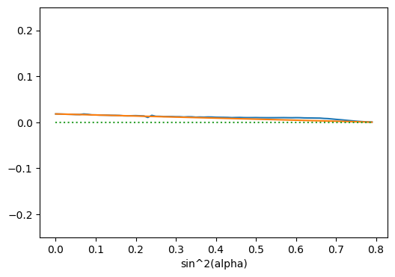
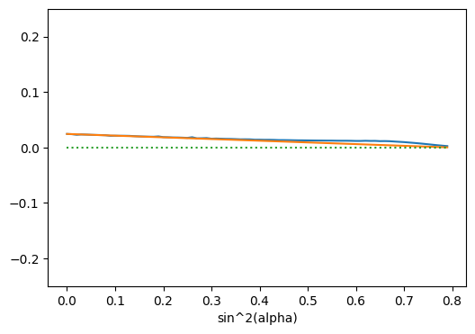
(a)
(b)
(c)
(d)
(e)
(f)
(g)
(h)
(i)
Ideal (orange) vs. measured (blue) two-term Shuey trends at each impedance-contrast interface. Densities are in kg m⁻³; velocities in m s⁻¹. (a) Found contrast at rho = 2125, 2200; Vp = 3600, 3650; Vs = 2025, 2050. (b) Found contrast at rho = 2200, 2250; Vp = 3650, 3700; Vs = 2050, 2075. (c) Found contrast at rho = 2250, 2351; Vp = 3700, 3750; Vs = 2075, 2070. (d) Found contrast at rho = 2351, 2203; Vp = 3750, 3700; Vs = 2070, 2040. (e) Found contrast at rho = 2203, 2129; Vp = 3700, 3650; Vs = 2040, 1990. (f) Found contrast at rho = 2129, 2203; Vp = 3650, 3700; Vs = 1990, 2040. (g) Found contrast at rho = 2203, 2351; Vp = 3700, 3750; Vs = 2040, 2070. (h) Found contrast at rho = 2351, 2129; Vp = 3750, 3650; Vs = 2070, 1990. (i) Found contrast at rho = 2129, 2500; Vp = 3650, 3800; Vs = 1990, 2100.

Slide 15
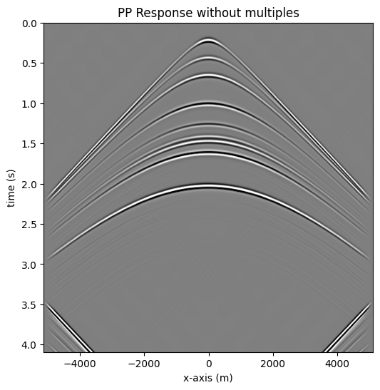
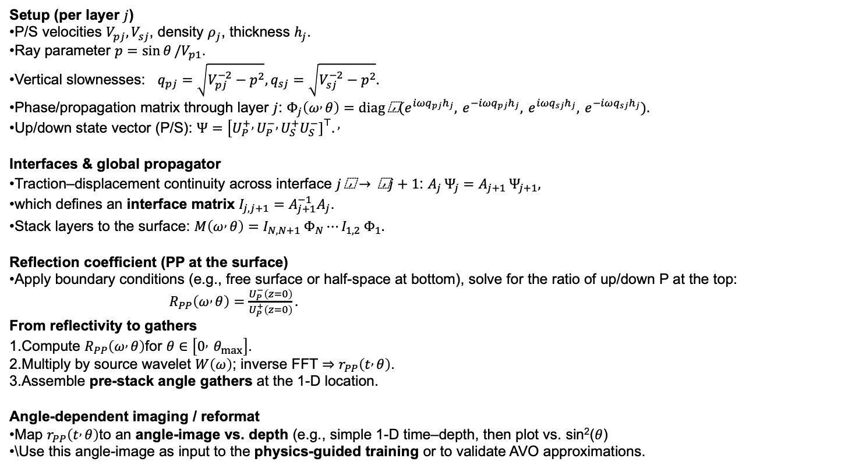
Chapter 2: Data and Forward Modeling
2.5 Full, frequency- and angle-dependent response(1D)
Kennett's reflectivity method(1-D layered medium)
Thomson–Haskell/propagator approach for a horizontally layered, isotropic 1-D earth.
Computes the full, frequency- and angle-dependent response (PP, PS, multiples).
Used here at one lateral location (1-D); later reformatted to an angle-image.
Setup (per layer $j$)
P/S velocities $V_{pj},V_{sj}$, density $ρ_{j}$, thickness $h_{j}$.
Ray parameter $p=\sin{θ}/V_{p1}$.
Vertical slownesses: $q_{pj}=\sqrt{V_{pj}^{−2}−p^{2}}, q_{sj}=\sqrt{V_{sj}^{−2}−p^{2}}.$
Phase/propagation matrix through layer $j$: $Φ_{j}\left(ω , θ\right)=diag \text{⁣}(e^{iωq_{pj}h_{j}}, e^{−iωq_{pj}h_{j}}, e^{iωq_{sj}h_{j}}, e^{−iωq_{sj}h_{j}}).$
Up/down state vector (P/S): $Ψ=[U_{P}^{+} , U_{P}^{−} , U_{S}^{+}U_{S}^{−}{\left.]\right.}^{⊤}.,$
Interfaces & global propagator
Traction–displacement continuity across interface $j \text{⁣}→ \text{⁣}j+1$: $A_{j} Ψ_{j}=A_{j+1} Ψ_{j+1},$
which defines an interface matrix $I_{j,j+1}=A_{j+1}^{−1}A_{j}$.
Stack layers to the surface: $M\left(ω , θ\right)=I_{N,N+1} Φ_{N}⋯I_{1,2} Φ_{1}.$
Reflection coefficient (PP at the surface)
Apply boundary conditions (e.g., free surface or half-space at bottom), solve for the ratio of up/down P at the top:
$R_{PP}\left(ω , θ\right)=\frac{U_{P}^{−}\left(z=0\right)}{U_{P}^{+}\left(z=0\right)}.$
From reflectivity to gathers
Compute $R_{PP}\left(ω , θ\right)$for $θ∈\left[0 , θ_{max}\right]$.
Multiply by source wavelet $W\left(ω\right)$; inverse FFT $⇒r_{PP}\left(t , θ\right)$.
Assemble pre-stack angle gathers at the 1-D location.
Angle-dependent imaging / reformat
Map $r_{PP}\left(t , θ\right)$to an angle-image vs. depth (e.g., simple 1-D time–depth, then plot vs. sin²($θ$)
\Use this angle-image as input to the physics-guided training or to validate AVO approximations.

Slide 16
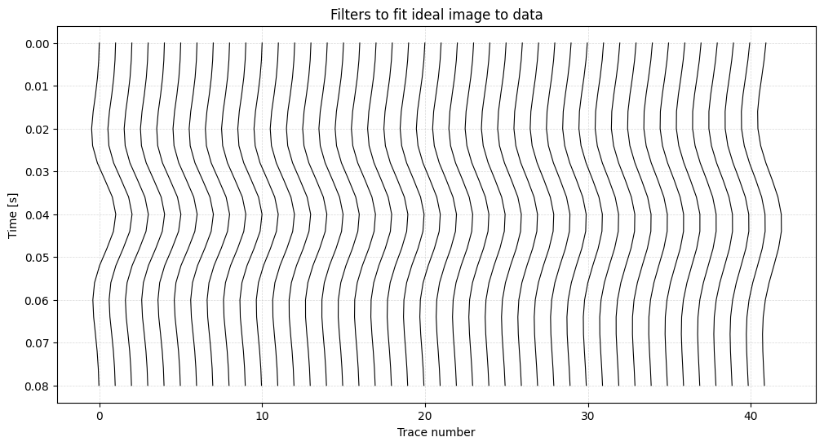
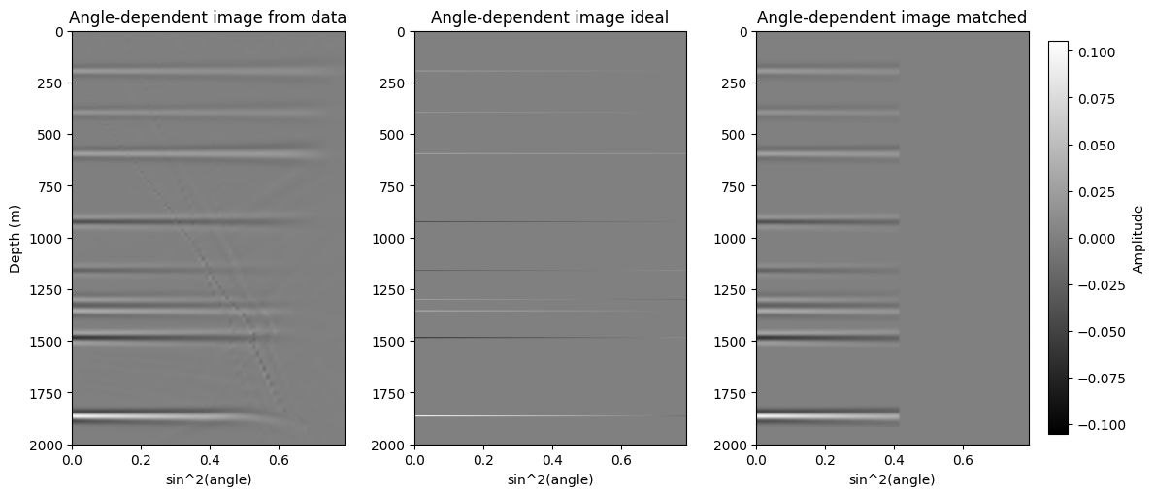
Chapter 2: Data and Forward Modeling
2.6 Wavelet extraction and convolution
R_matched = R_ideal * filter
They can agree approximately for a single interface, weak contrasts, and small angles—i.e., when fitting Shuey’s form to PP amplitudes simulated by Kennett’s method—but they are not the same in scope or accuracy.
Fig.8 Angle dependent images

Slide 17
Chapter 2: Data and Forward Modeling
Fig.7 Angle-dependent shaping filter estimated by least-squares matching of ideal to migrated amplitudes.

Slide 18
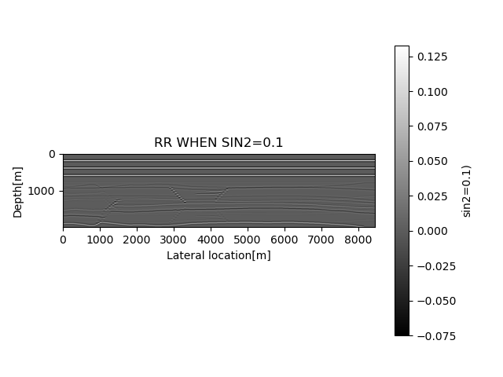


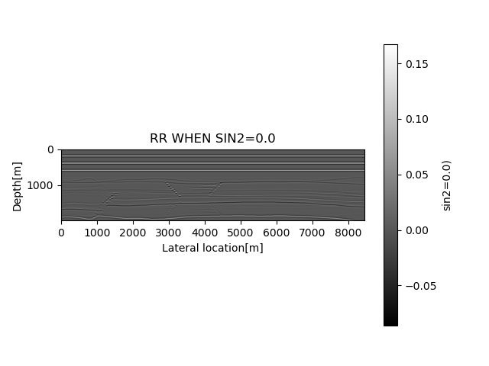
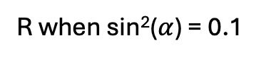
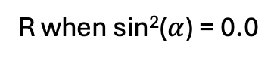
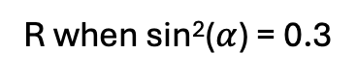
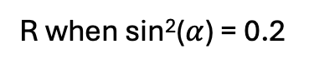
Chapter 2: Data and Forward Modeling
R when sin²($α$) = 0.0
R when sin²($α$) = 0.1
R when sin²($α$) = 0.2
R when sin²($α$) = 0.3
Fig.12 Ideal reflection convolved with filter at year of 100

Slide 19
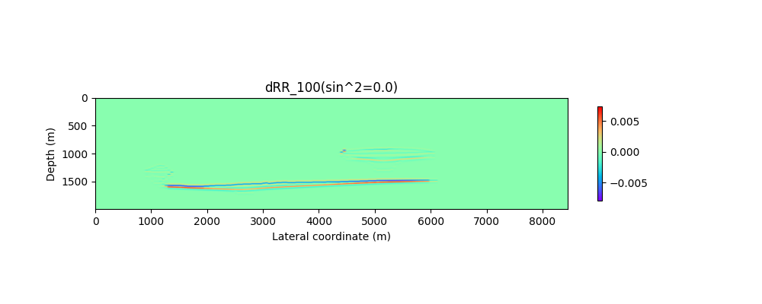
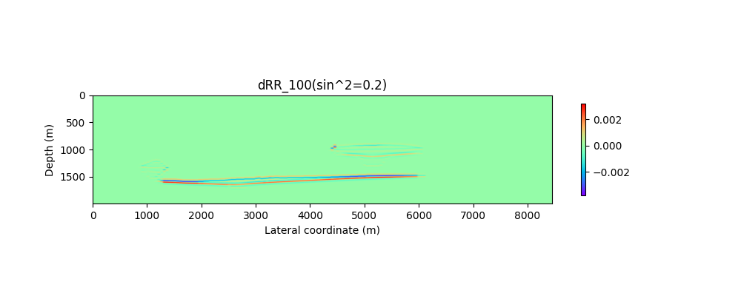
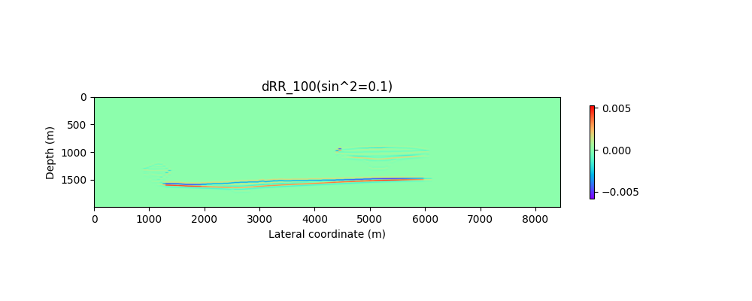
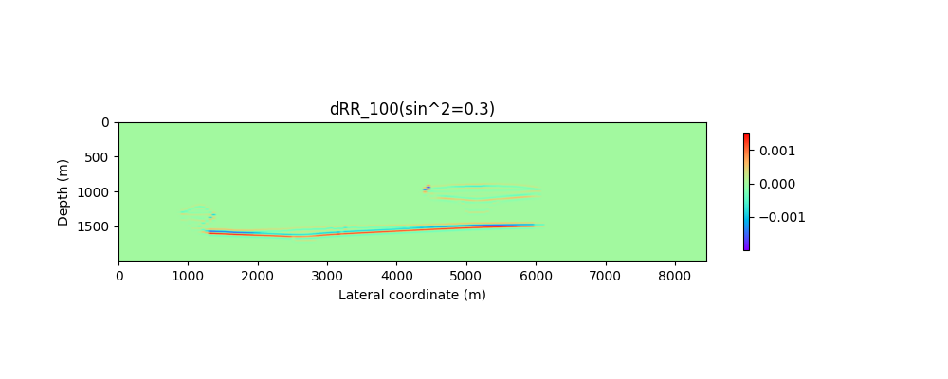
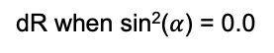
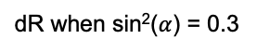
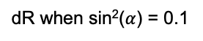
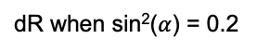
Chapter 2: Data and Forward Modeling
dR when sin²($α$) = 0.0
dR when sin²($α$) = 0.1
dR when sin²($α$) = 0.2
dR when sin²($α$) = 0.3
Fig. Residuals of angle gathers at four angles (sin²($α$) = 0.0, 0.1, 0.2, 0.3) in the year of 100

Slide 20
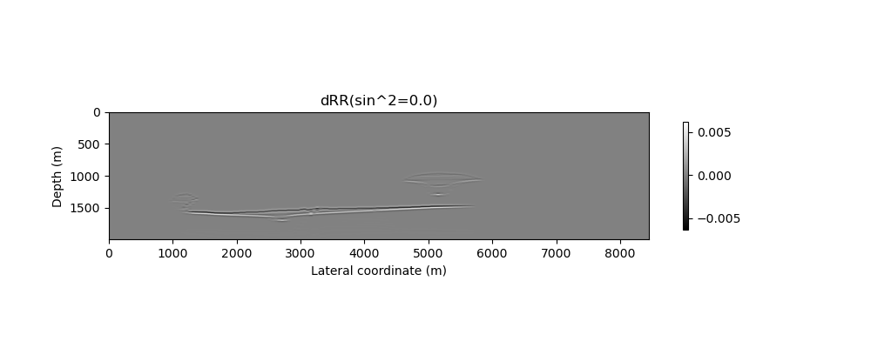
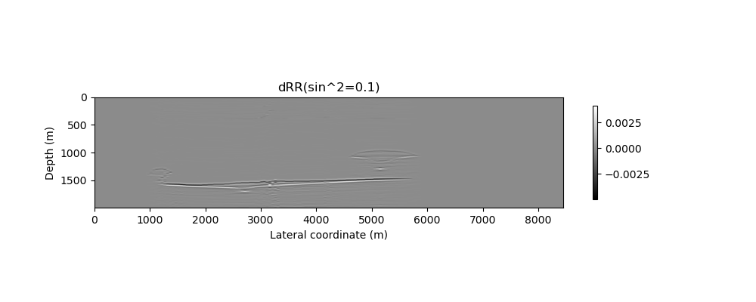
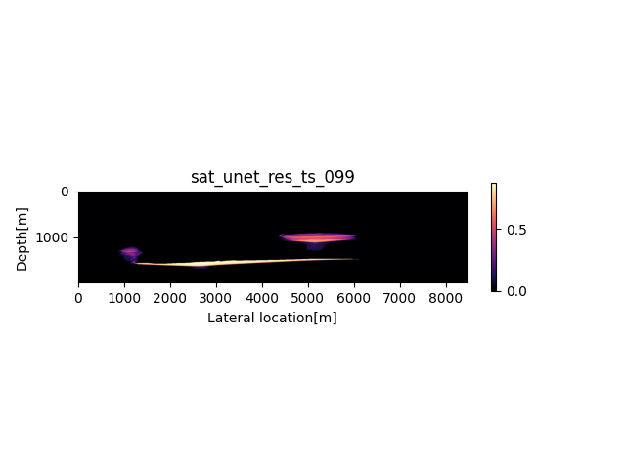
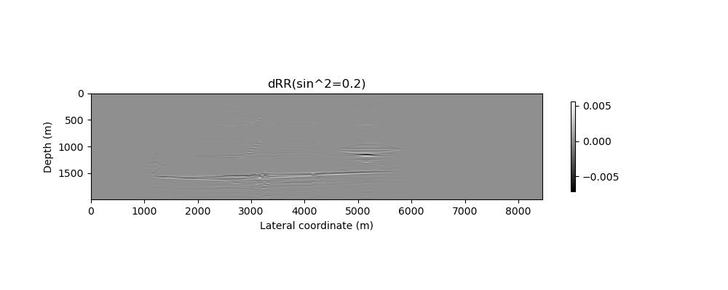

Chapter 3: Methodology
-
Modelled dR
(4 angles)
Geophysical
Forward
(B, 1, 400, 170)
(B, 4, 400, 170)
ResConv 64
+
ResConv 64
ResConv 128
+
ResConv 128
ResConv 256
+
ResConv 256
Maxpool x2
ResConv 512
+
ResConv 512
Upsample x2 Conv 1x1
Skip connection
ResConv 1024
Conv 1x1
Transformer
Tokens = (H/16·W/16), Dim = 1024, Heads = 4, Layers = 2, MLP×4
Notes:
four‐angle dRR input (B, 4, H, W) passes through a 4-stage encoder of residual conv blocks. A 1024-channel bottleneck is processed by a 2-layer, 4-head transformer (token count H/16·W/16). The decoder upsamples with 1×1 projection, concatenates aligned skip features, and refines via ResConv. Final 1×1 yields the saturation map.”

Slide 21
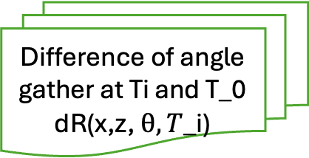
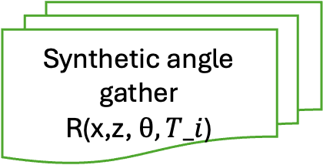
Fig. Geophysical forward modeling
Chapter 3: Methodology
What does it mean by “physics-guided”?
Predicted Saturation map
Gasmann’s Law
Elastic properties:
Density, Vp, Vs models at T_i
Shuey approx.
PP reflection coefficient
Wave covolution
Difference of angle gather at Ti and T_0
dR(x,z, $θ, T$_i)
Synthetic angle gather
R(x,z, $θ, T_i$)
Notes:
.Angle-dependent imaging via linear Radon domain: 1)apply linear Radon/Tau-P transform of the data, to decompose in plane wave responses; 2)actual migration via phase shifts in Tau-P domain;
Select 4 angls from angle-dependent image and merge all over the lateral locations to generate 2D x,z images

Slide 22
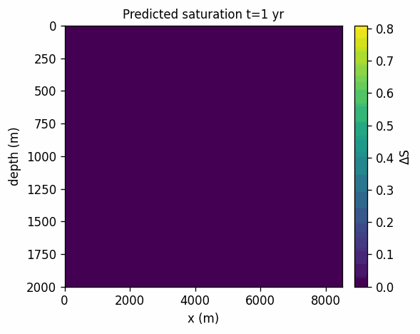

Chapter 4: Results and analysis

Slide 23




Chapter 4: Results and analysis

Slide 24


Chapter 4: Results and analysis

Slide 25

Chapter 5: Discussion
5.1 Uncertainty qualification
GT vs Prediction : The location and extent of the plume are uncertain
Fig. NRMS history over 800 years. The shaded region indicates the training (seen) window; the rightmost segment is the unseen evaluation win- dow. Early years show an elevated transient tied to rapid plume growth; the mid sequence stabilizes with intermittent spikes associated with abrupt geometric updates; the unseen interval exhibits a step-up in NRMS while preserving plume localization.

Slide 26



Chapter 5: Discussion
5.1 Uncertainty qualification
Fig. Representative frames at t =6, 360, 798 yr.
Left: ground truth ∆S.
Middle: prediction.
Right: absolute error with NRMS indicated.

Slide 27
Chapter 5: Discussion
5.2 What’s been improved?
The current evaluation would benefit by comparing with pre- dictions generalized by near-zero angle gather trained model. This will explicitly quantify the incremental value of multi-angle seismic information and to isolate failure modes that persist even without angular information.
Synthetic data for training but can be deployed at real cases.
We are not replacing the traditional CO₂ characterization but just provide a fast analysis for CO₂ migration

Slide 28
Chapter 5: Discussion
5.3 What can be potentially improved?
First, the method is most stable when the input angles are restricted to a moderate range (e.g., sin² α ≤ 0.4), consistent with the validity regime of the two-term linearization; if impedance contrasts are stronger, robustness can be improved by extending the forward model via either the third Shuey term or full Zoeppritz reflectivity, at a mod- est additional cost. Or we just fit the reflectivity with a more proper wavelet shape
Second, wavelet and acquisition imprint can be handled more flexibly: while per-angle shaping already reduces systematic bias, residual mismatches can be further reduced by introducing slowly varying gain fields g(x, θ) with spatial regularization and by applying a limited phase-only correction (restricted to a few samples) to absorb small timing drifts.
Third, from an operational standpoint, even when plume edges are somewhat softened, accurate plume localization is often sufficient to track plume extent (a key containment metric), and this can be strengthened by adding an explicit reservoir-scale mass-balance check that is simple to audit.

Slide 29
Chapter 5: Discussion
5.4 Limitations:
Dimensionality of the training data: we synthesize 1.5D examples rather than full 2D/3D seismic images, effectively stacking 1D reflectivity responses along the lateral axis to form a pseudo-2D section; while this enables efficient training, it can under-represent genuine 2D/3D wave-propagation effects (e.g., lateral heterogeneity, diffractions, and finite- offset moveout complexity) that may influence angle gathers in practice.
AVO forward model: the current two-term linearized formulation is most reliable for small-to-moderate angles and mod- est impedance contrasts, and performance may degrade at larger (yet sub- critical) angles or in high-contrast settings.
Using a lightweight porosity mask as a soft spatial prior improves geometric fidelity by steering the model toward the reservoir architecture, but it introduces brittleness where the prior is violated (e.g., unmodelled leakage paths or faults).

Slide 30
Chapter 5: Discussion
5.5 Experiments on different architecture or architectural depth:
Reducing architectural depth (fewer encoder/decoder stages or residual blocks) led to systematic performance losses relative to the current depth. Quantitatively, we observed higher validation NRMS and angle-consistency residuals, and larger plume extent errors. Qualitatively, saturation maps exhibited softened boundaries, attenuated thin features, and reduced interior contrast—consistent with a smaller effective receptive field and lower representational capacity. Training dynamics also indicated underfitting: the training loss plateaued earlier, and the gap between training and validation curves narrowed without corresponding accuracy gains. Overall, the results suggest that the depth used in this thesis is near the minimum required to preserve plume geometry and temporal coherence under the adopted physics-guided loss.
Unet, ResNet, Transformer and UNet-ResNet are all outperformed by the current architecture.

Slide 31
Chapter 6: Conclusion
This frame work can recover time–lapse CO₂ saturation from angle gathers by combining a physics-guided forward operator with a learning model that exploits the structure of the data.
The principal residuals are amplitude–related rather than geometric. Inside the plumes the predicted saturation exhibits a reduced dynamic range (attenuated gradients) and along plume rims the transitions are broadened. These effects are explained by the band–limit of the angle–gather imaging operator and by the smoothness-promoting regularization used during training; they do not displace the plumes.
Using a lightweight porosity mask as a soft spatial prior improves geometric fidelity by steering the model toward the reservoir architecture, but it introduces brittleness where the prior is violated (e.g., unmodelled leakage paths or faults). Treating the mask as a tuneable prior and stress testing with deliberate perturbations provides a pragmatic compromise between guidance and adaptability.

Slide 32
Reference
Qi Hu, Dario Grana, Kristopher A Innanen, Feasibility of seismic time-lapse monitoring of CO₂ with rock physics parametrized full waveform inversion, Geophysical Journal International, Volume 233, Issue 1, April 2023, Pages 402–419, https://doi.org/10.1093/gji/ggac462
Øyvind Marcussen, Tom Erik Maast, Nazmul H. Mondol, Jens Jahren, Knut Bjørlykke, Changes in physical properties of a reservoir sandstone as a function of burial depth – The Etive Formation, northern North Sea,Marine and Petroleum Geology,Volume 27, Issue 8, 2010, Pages 1725-1735, ISSN 0264-8172, https://doi.org/10.1016/j.marpetgeo.2009.11.007.(https://www.sciencedirect.com/science/article/pii/S0264817209002104)
Nordbotten, Jan M., Ferno, Martin A., Flemisch, Bernd, Kovscek, Anthony R., and Knut-Andreas Lie. "The 11th Society of Petroleum Engineers Comparative Solution Project: Problem Definition." SPE J. 29 (2024): 2507–2524. doi: https://doi.org/10.2118/218015-PA
Open Delft Advanced Research Terra Simulator. https://github.com/openjournals/joss-reviews/issues/6737.
Zhi Zhong, Alexander Y. Sun, Qian Yang, Qi Ouyang. A deep learning approach to anomaly detection in geological carbon sequestration sites using pressure measurements. Journal of Hydrology. 2019. 573. 885-894.
Gao et al. STransFuse: Fusing Swin Transformer and Convolutional Neural Network for Remote Sensing Image Semantic Segmentation. IEEE Journal of Selected Topics in Applied Earth Observations and Remote Sensing. 2021.
M. Araya-Polo, S. Farris, and M. Florez, “Deep learning-driven velocity model building workflow,” The Leading Edge, vol. 38, no. 11, 872a1– 872a9, 2019.
V. Kazei, A. Titov, W. Li, et al., “Predicting density and velocity ahead of the bit with zero-offset vsp using deep learning,” in First Interna- tional Meeting for Applied Geoscience & Energy (IMAGE), SEG, 2021, pp. 1450–1454.
Y. Liu and Y. Zhong, “Machine learning-based seafloor seismic prestack inversion,” IEEE Transactions on Geoscience and Remote Sensing, vol. 59, no. 5, pp. 4471–4480, 2020.
S. Khandoozi, R. Hazlett, and M. Fustic, “A critical review of co2 mineral trapping in sedimentary reservoirs—from theory to application: Pertinent parameters, acceleration methods and evaluation workflow,” Earth-Science Reviews, vol. 244, p. 104 515, 2023

Slide 33

Q&A Any question?

